Slide 1
Week 3 Presentation
11107014
林冠良

Slide 2
I²C
A synchronous, multi-controller/multi-target (controller/target), packet switched, single-ended, serial communication bus.

Slide 3
Inter-Integrated Circuit
Uses only two bidirectional open-collector or open-drain lines.
Serial data line (SDA)
Serial clock line (SCL)
Pulled up with resistors.
7-bit address space
1 byte(8-bit) data frame
Speed
Standard mode: 100 kbit/s
Fast mode: 400 kbit/s

Slide 4
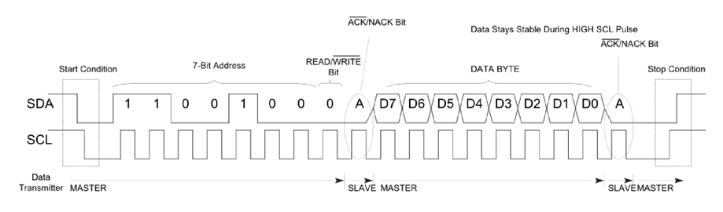
Timing Diagram

Slide 5
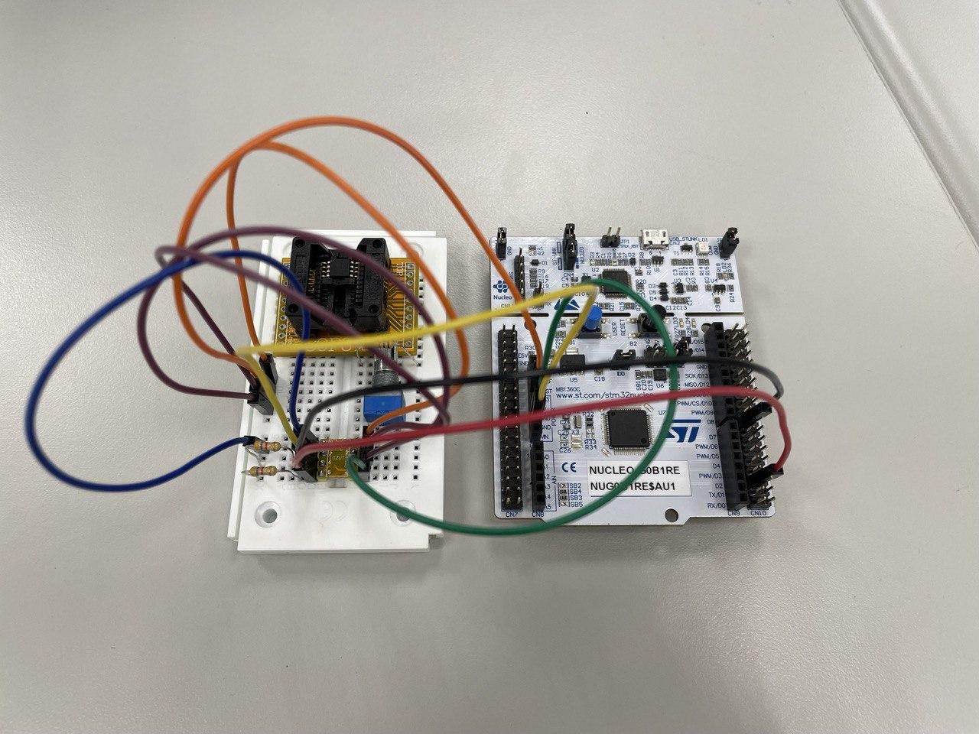
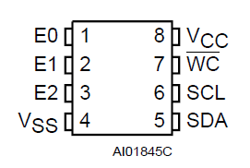
Circuit
E0, E1, E2 and VCC connected to 3V3 in series.
VSS and WC connected to GND.
SCL connected to PA9.
SDA connected to PA10.
Horizontally opposite!

Slide 6
Coding
I2C_EEPROM

Slide 7
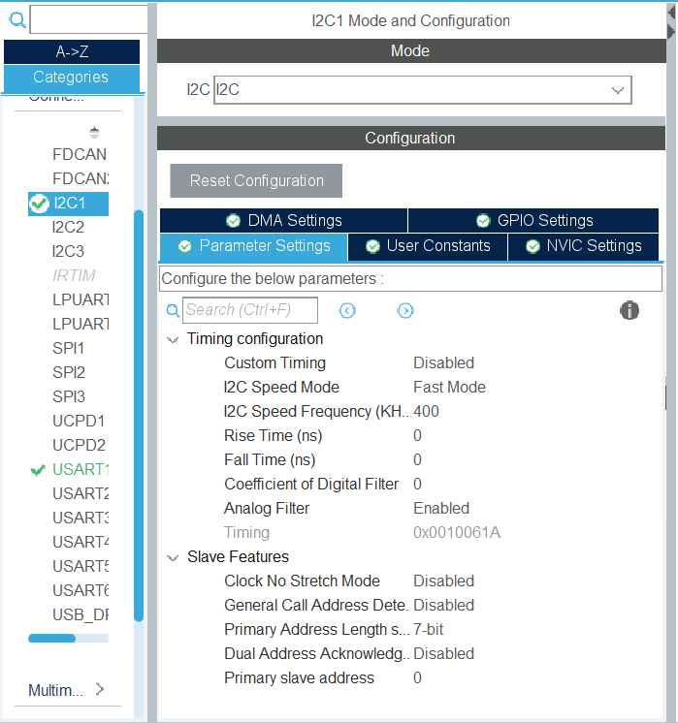
Enable I2C
Enable I2C1
Speed Mode: Fast Mode
I2C Speed Frequency: 400KHz

Slide 8
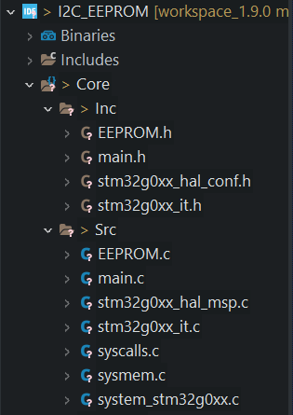
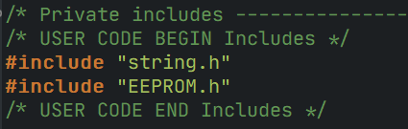
Add additional files
Add implementations header file and c files in both Inc and Src folders.
Include added file in main.c

Slide 9
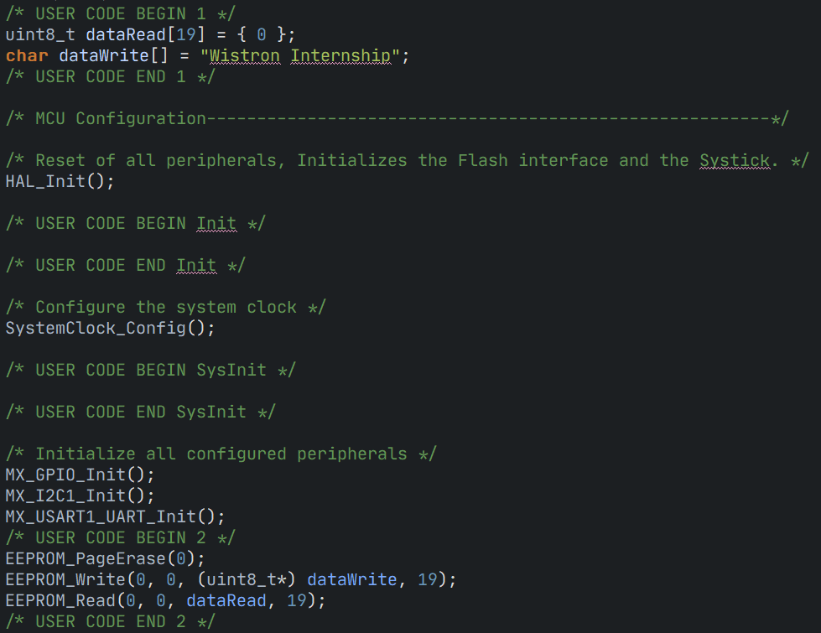
Coding
Initialize an uint8_t array dataRead.
Initialize an char array dataWrite.
Size: 19 include ‘\0’
“Wistron Internship”
Erase all pages in EEPROM.
Convert dataWrite to uint8_t* and write it into EEPROM with page 0, offset 0 and size 19.
Read data in EEPROM to dataRead with from page 0, offset 0 and size 19.

Slide 10
Results

Slide 11

Thank you for your listening
林冠良
Noah_Lin@wistron.com
https://github.com/popshia

